Slide 1
DEPARTMENT OF ART
PRESENTATION BY :-
MRS. SEEMA JAITLY
ASSISTANT PROFESSOR
Class :- B.SC.(Home Science)
Sem 3

Slide 2
PRINCIPLES OF ART

Slide 3
The principles of art help artists plan their art and think about how other people will react to the artwork.
The principles are the base of every artwork. It helps in creating unity in our painting or any art work.

Slide 4
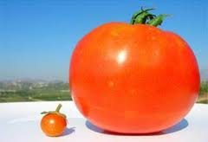
BALANCE
Balance is the arrangement of art elements to produce a visual Equilibrium.

Slide 5
Types Of Balance
..
Balance creates equality on both the sides.
In any art works .
TYPES OF BALANCE
Formal Balance – In which both sides creates
a sence of equality. Gives a complete look.
Informal Balance – In which one side is having
smaller thing then the other side.
Not equal but looks complete.

Slide 6
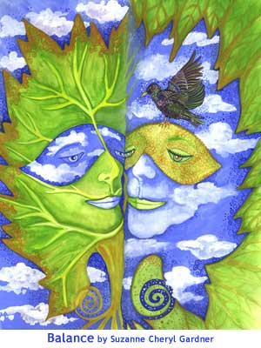
BALANCE

Slide 7
PROPORTION
The proportion principle is now and then called code of relations. It is unani principle that the length and width of any place or thing should have PROPORTION.

Slide 8
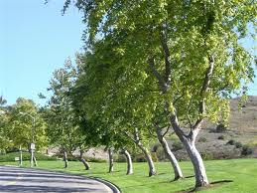
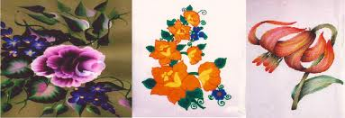
PROPORTION

Slide 9

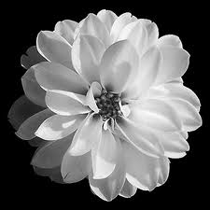
2 (a). Proportion –
Geometrical
Floral
Natural

Slide 10
PERSPECTIVE
The objects which are closer to us appears to be larger in size and dark in colour whereas the objects which are far away from us appears to be smaller in size and dull in colour.

Slide 11
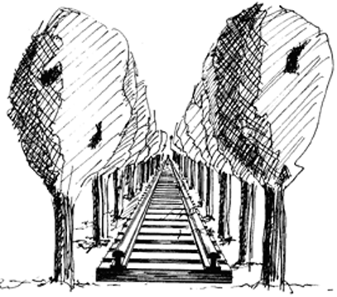

Slide 12
RYTHM
Rythm is a repetition of art elements providing progressive and related movement.
Continous Movement.

Slide 13
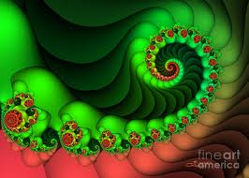
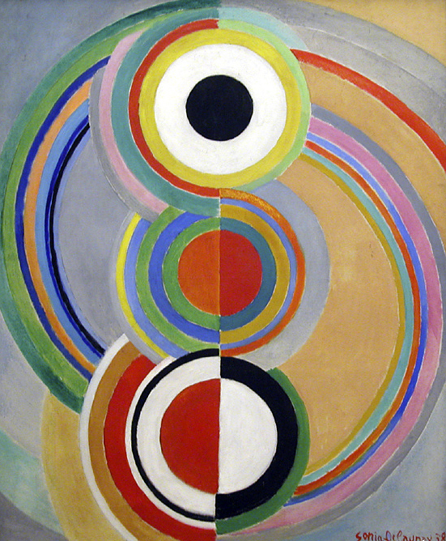
RYTHM

Slide 14
OPPOSITION
Opposition is visual tension as day and night.

Slide 15
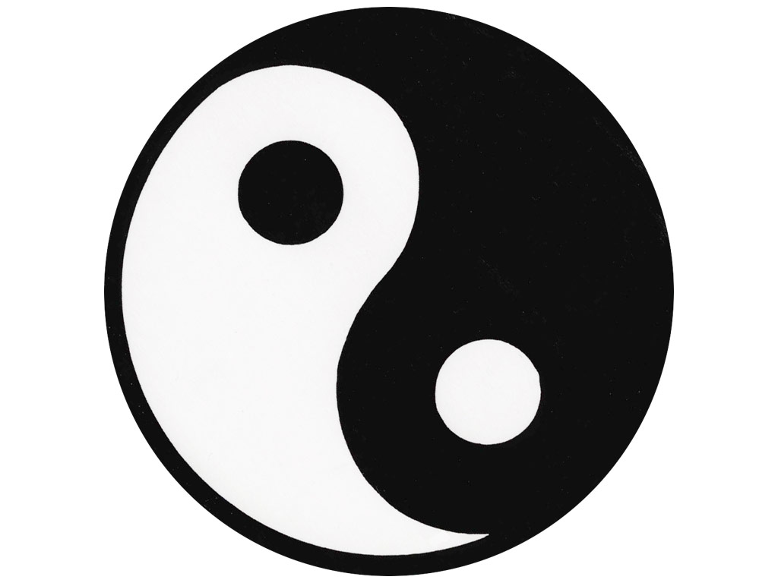
OPPOSITION

Slide 16
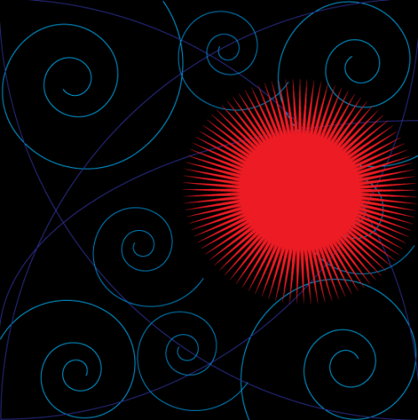
DOMINANCE
Dominance is the emphasis of one part over the other. Subordination of other parts results.

Slide 17
3. DOMINANCE

Slide 18
TRANSITION
Transition is a unifying movement from one art element to another.

Slide 19
HARMONY
It is the art principle which produce an impression of unity. When all the objects of creation gives us the feeling of same family.
It is a state of agreement or orderly arrangement to color, size, shape etc

Slide 20
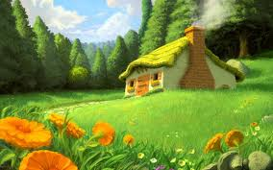
HARMONY

Slide 21
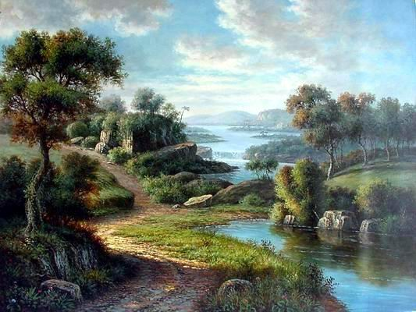
HARMONY

Slide 22
The end

