Slide 1

SUPPORT SYSTEM IN OLD AGE

Slide 2
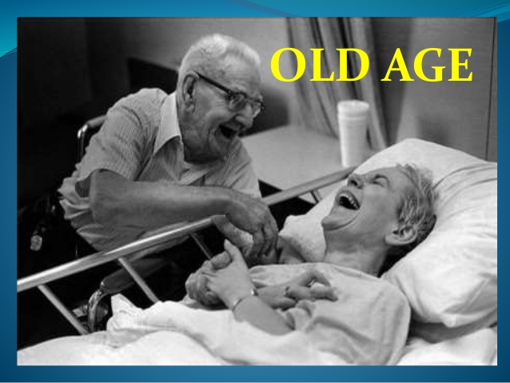

Slide 3
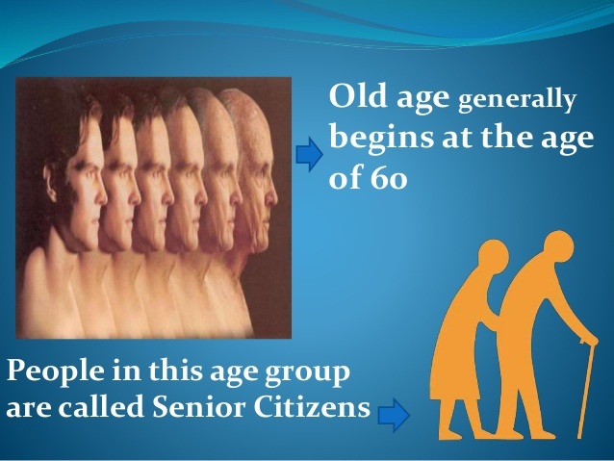

Slide 4


Slide 5
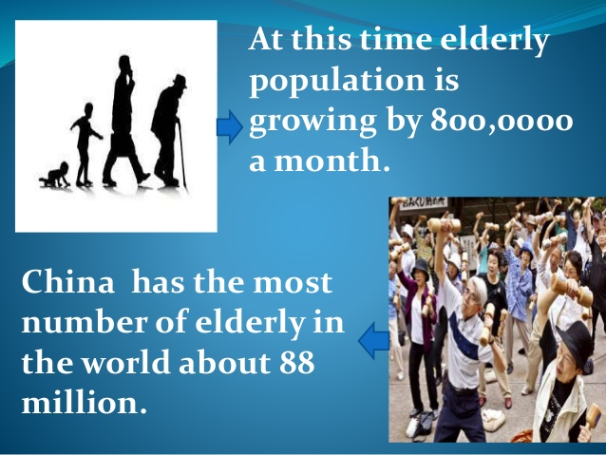

Slide 6

See the video below to see some innovative ways to look after the elderly in this busy world

Slide 7
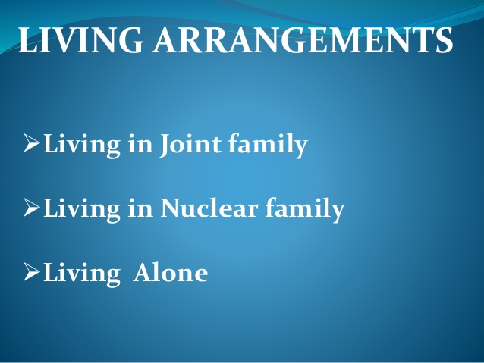

Slide 8
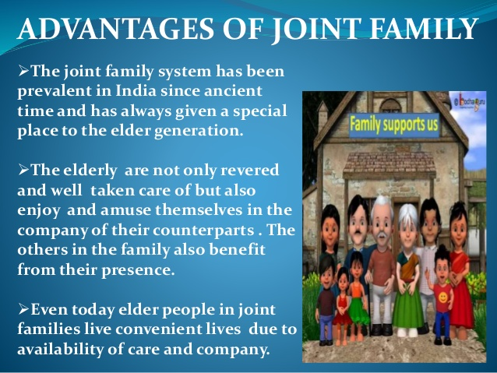

Slide 9


Slide 10


Slide 11


Slide 12


Slide 13


Slide 14
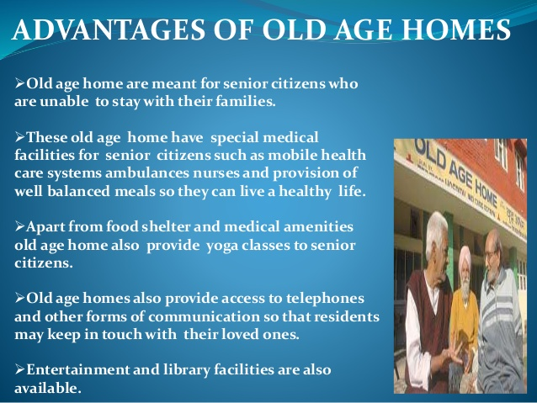

Slide 15
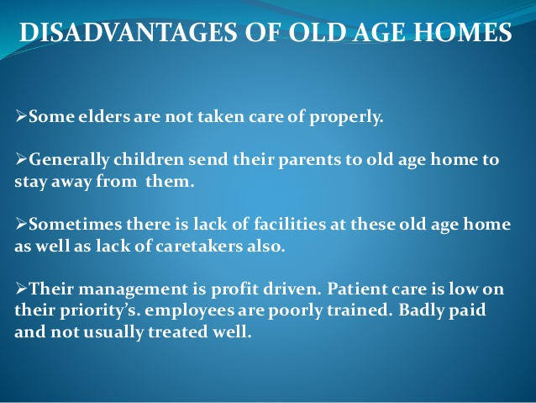

Slide 16
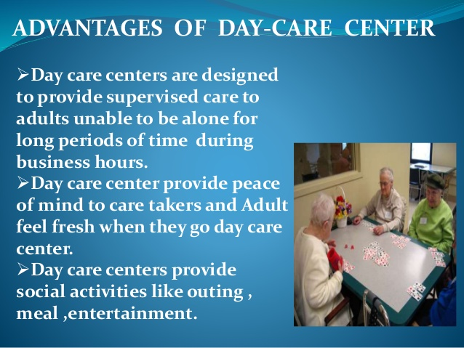

Slide 17

OLD AGE DAY CARE CENTRE

Slide 18
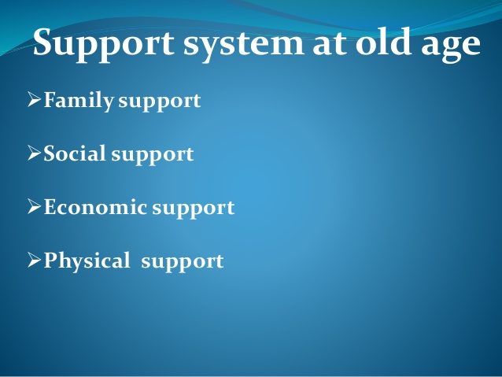

Slide 19


Slide 20
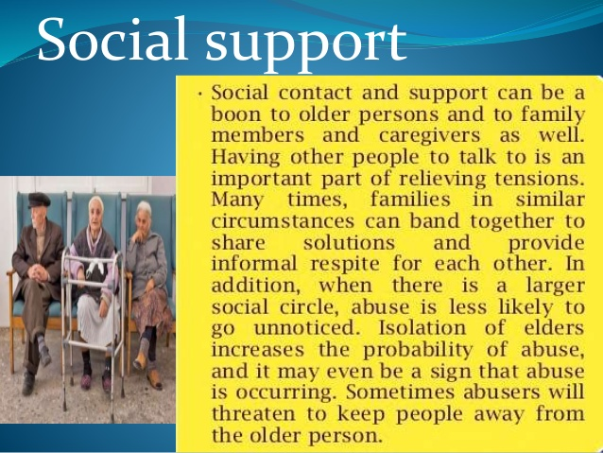

Slide 21


Slide 22


Slide 23
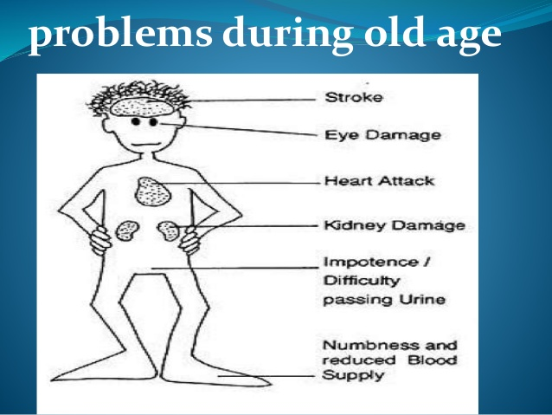

Slide 24


